Slide 1

DETECTION OF AI-GENERATED ARABIC TEXT
Presented by
Haneen Alahmadi

Slide 2

Introduction
This project focuses on detecting AI-generated Arabic text using machine learning and transformer-based models to support content authenticity and academic integrity.

Slide 3
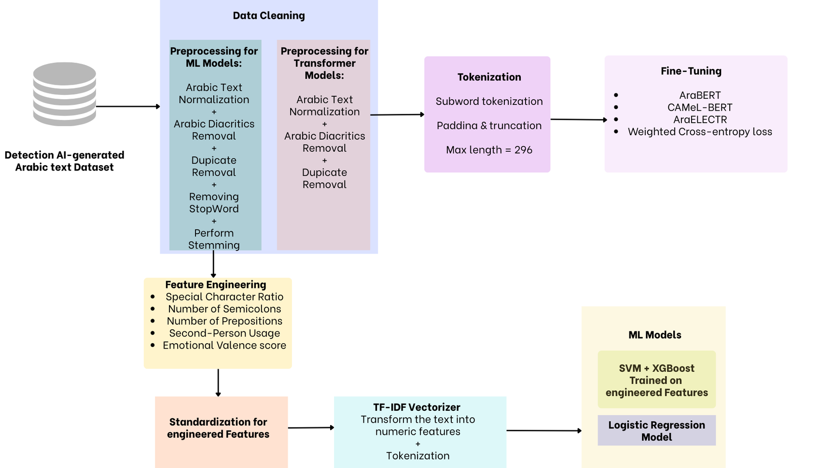
Project WorkFlow

Slide 4
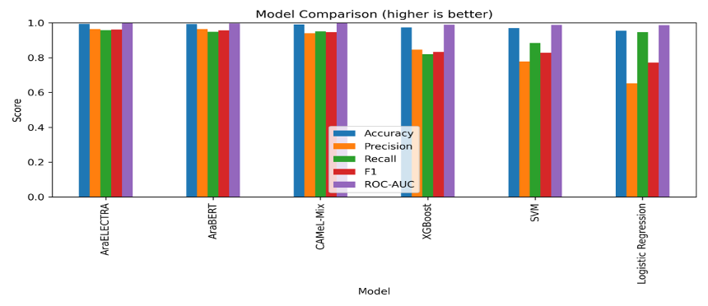
Model Comparison

Slide 5
Thank you

